Slide 1


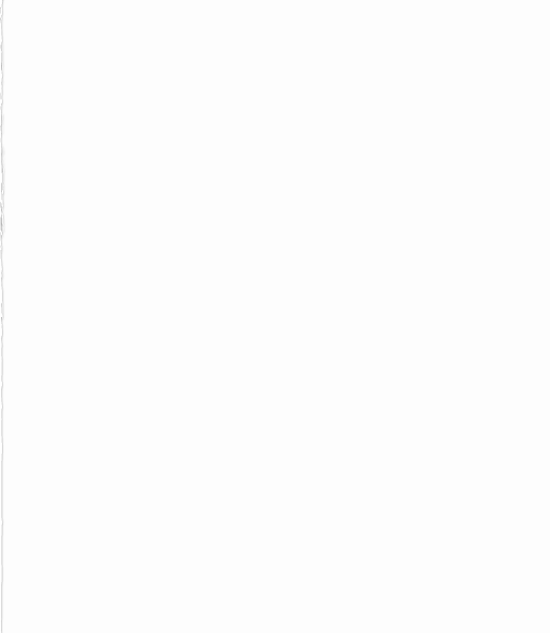
Intro to Django for Beginners As presented by Stuart Yee
This presentation will begin at 10am PST.
Questions will be taken at 11am PST.
This presentation is hosted by
The Next Iteration
These presentations are for and by us! If you’d like to participate or learn more, reach out to a mod!
Moderators:
Lisa
OneDirectChen#7802
Rene
thewaffle99#9522
Paul
Paul E#0147
Trevor
DeformedMallard#8388
Kai
Kain H#2761

